Slide 1
Open Source Policy Guidelines
This document is free to use for any purpose.
- You may modify or adapt the content.
- Attribution is required when reusing or publishing modified versions.
- The content is provided “as-is” without warranty.
- Do not include confidential or proprietary information when modifying.
- Sharing improvements with the community is encouraged .

Slide 2

AI Tools Usage Policy – Email Guidelines:
To ensure data privacy and maintain professional boundaries during AI tool experimentation:
Do not use personal or finance-linked email IDs when testing or evaluating AI tools.
Create a separate, dedicated email account specifically for learning, testing, and development purposes.
This practice helps safeguard sensitive information and ensures a clean separation between personal data and experimental workflows.

Slide 3
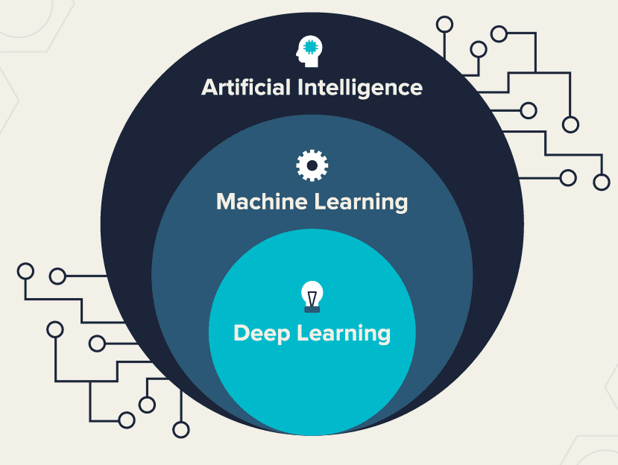
AI (Artificial Intelligence)
Artificial Intelligence (AI) - Machines can think, learn, and make decisions like humans. They can see, understand, and solve problems on their own.
Ai performs tasks similar to human intelligence. It can recognize patterns, understand speech, and Analyze/identify images.
AI can work without ML / DL by using methods like rule-based systems, robotics control, and fuzzy logic to make decisions and solve problems.
Machine learning (ML) is a Sub domain of artificial intelligence (AI). It teaches computers to learn patterns from data and make decisions using those patterns.
Deep learning (DL) is a Sub domain of of Machine learning (ML). It uses computer models called neural networks to learn from large amounts of data and make smart decisions. (DL) is primarily used for processing unstructured data such as images, audio, and Video..Etc...

Slide 4

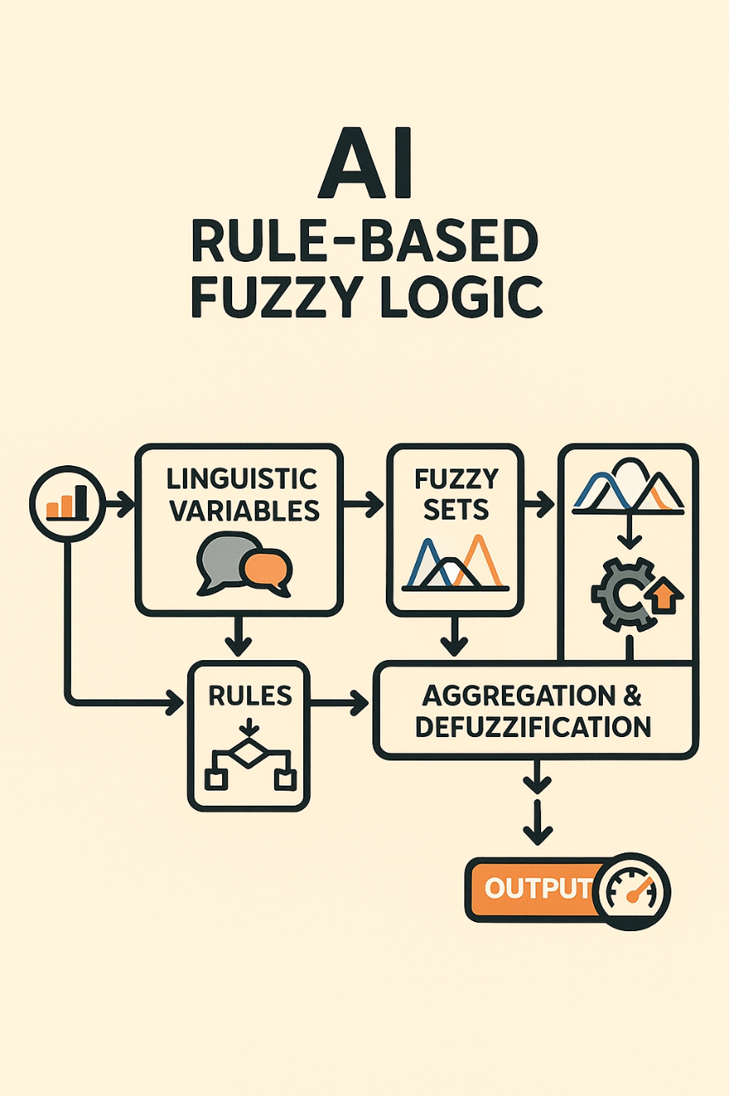
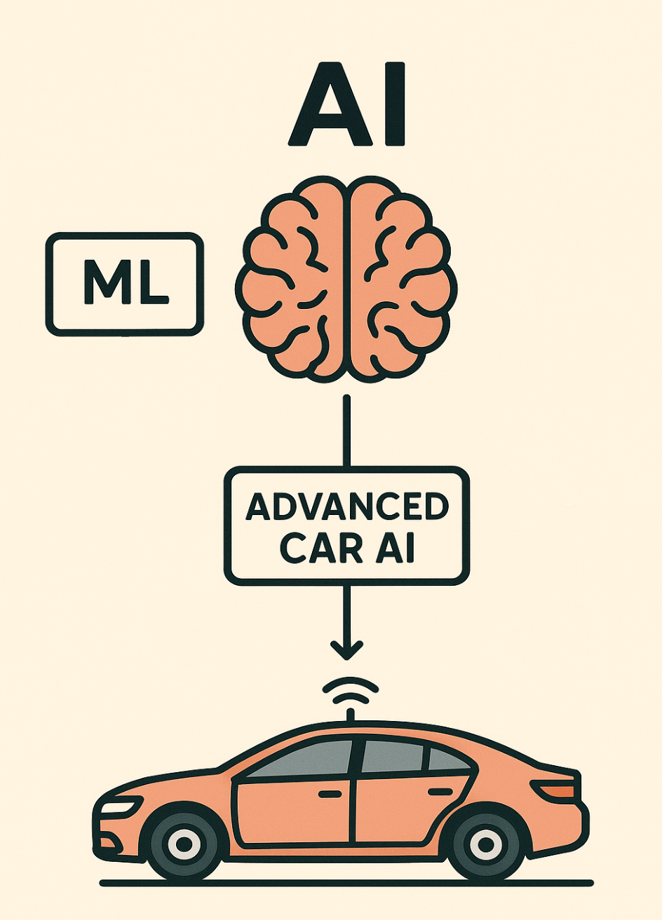
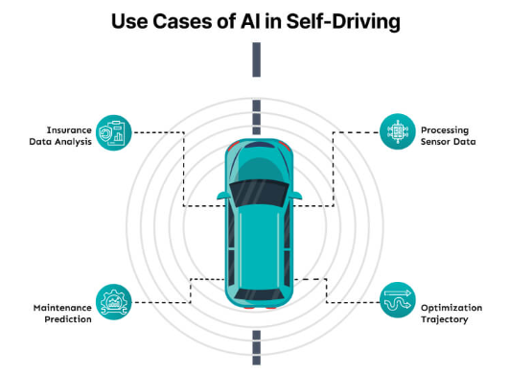

AI (Artificial Intelligence)

Slide 5
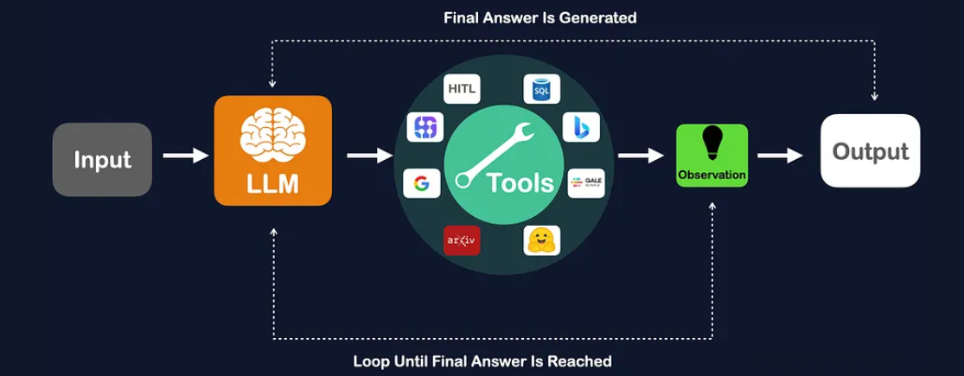
LLM = Large Language Model
LLM stands for Large Language Model, a type of artificial intelligence trained on vast amounts of text data to understand, process, and generate human-like text. These models use transformer architectures to learn language patterns and context, enabling them to perform tasks like text generation, translation, summarization, question-answering, and content creation. ChatGPT3 raw dataset size 45 TB before filtering and 1.7 - 1.8 trillion parameters.

Slide 6
Category | Tools
Text | GPT, Claude, Gemini, LLaMA.
Images | Midjourney, DALL·E, Stable Diffusion.
Audio | ElevenLabs, Bark, MusicGen.
Videos | Sora, Runway, HeyGen.
Code | Gitlab Duo, Copilot, Code Llama, Code Whisperer
Ai System Types:
Generative AI
AI Agent
Agentic AI

Slide 7
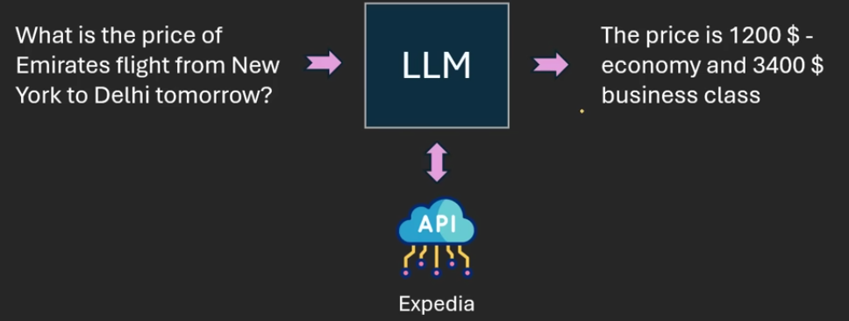
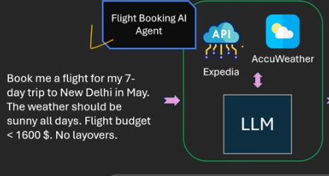
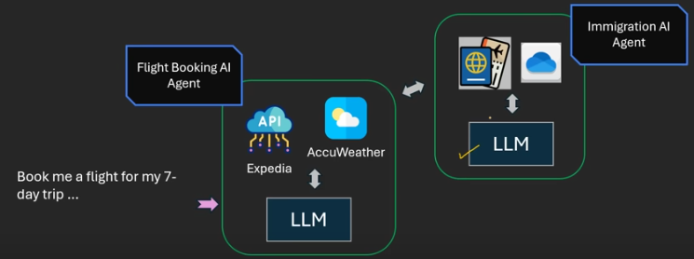
1
2
3
Ai System Type | Gen Ai (LLM Only) | Ai Agent | Agentic Ai
Task Capability | Answer based on pre Trained knowledge only. Like Text, images, audio and videos ChatGPT, Gemini | Task Input, Decide and Action/Completes a task using tools,Memroy,Data,api | Handle the multiple step with planning and co-ordination
Tool | No Extra Tool ☒ | Uses the Tools to complete the task | Uses multiple tools and call other AI agents.
Decision | No Decision Making ☒ | Make Decision complete the task | Plan , Decide and Autonomous Decision
1
2
3

Slide 8
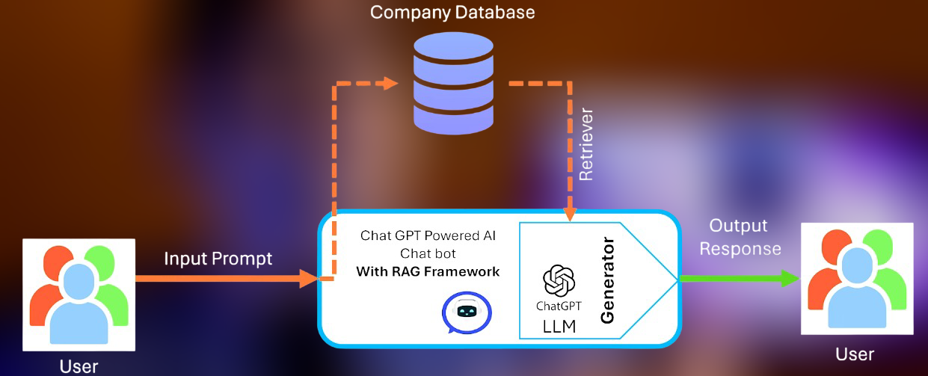
RAG = Retrieval Augmented Generation
RAG is an AI framework that improves the output of large language models (LLMs) by giving them access to external or private data up-to-date knowledge bases before generating a response.
RAG Powerful Knowledge/Documentation base retrieval.
RAG input text and get the output improved text output.

Slide 9
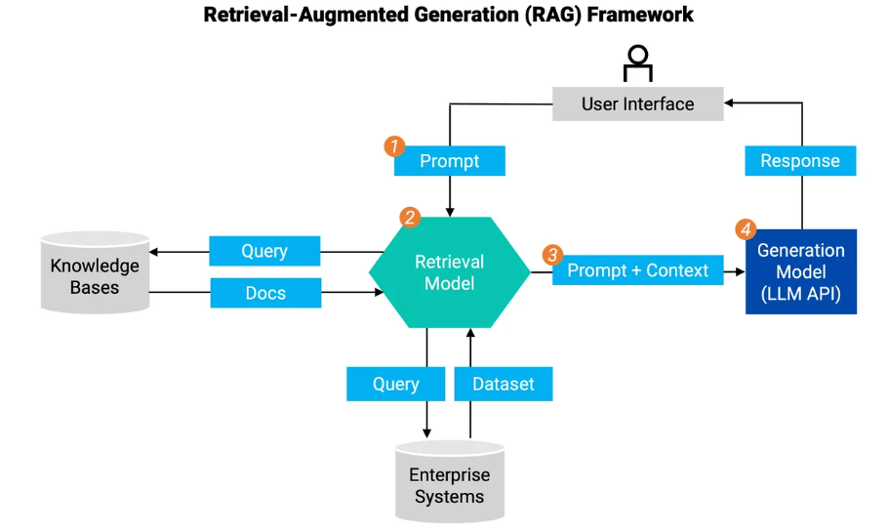


Slide 10
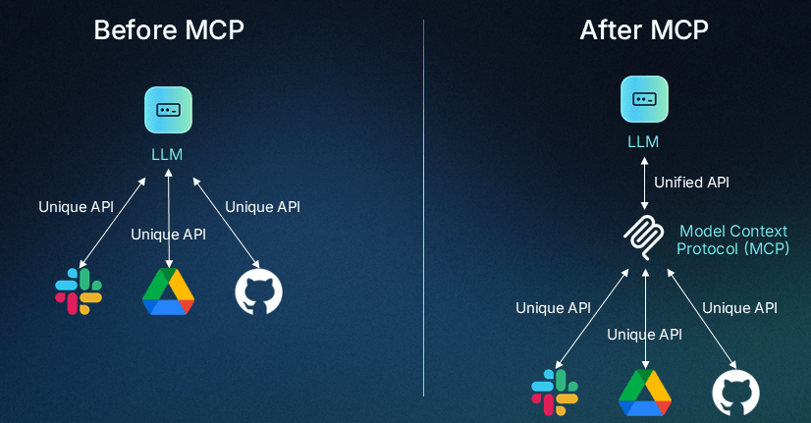
MCP - Model Context Protocol
Open-source framework that allows large language models (LLMs) to securely and standardized interact with external data sources and tools API, application,databases..etc.
MCP input text and get the output improved text and action output.
RAG and MCP combined integration tools more powerful.

Slide 11
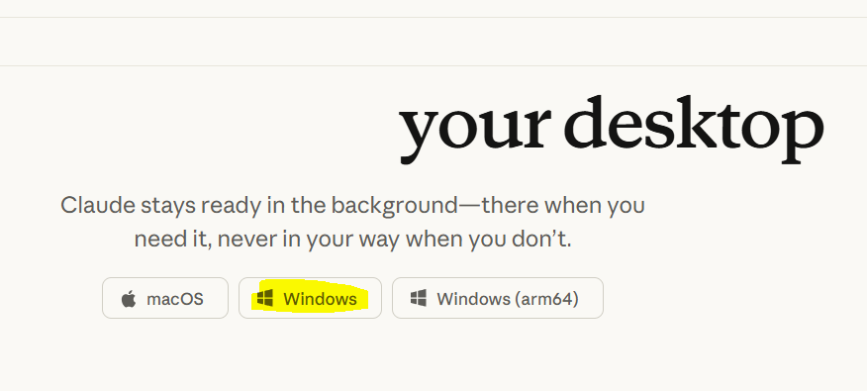
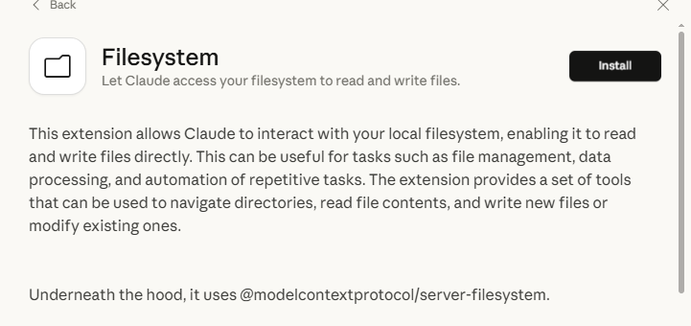
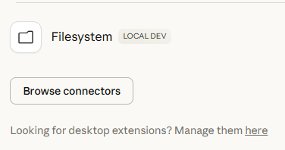
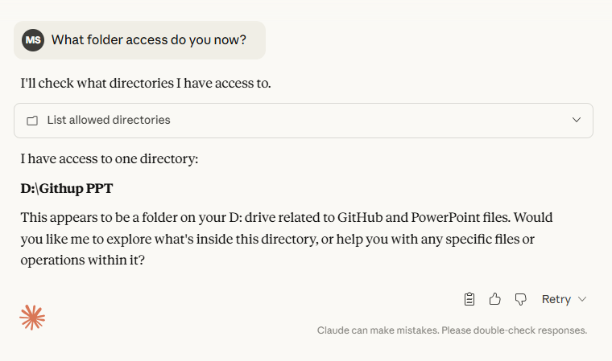
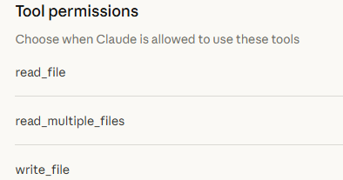
MCP – Example
2
https://www.claude.com/download
1
4
3

Slide 12
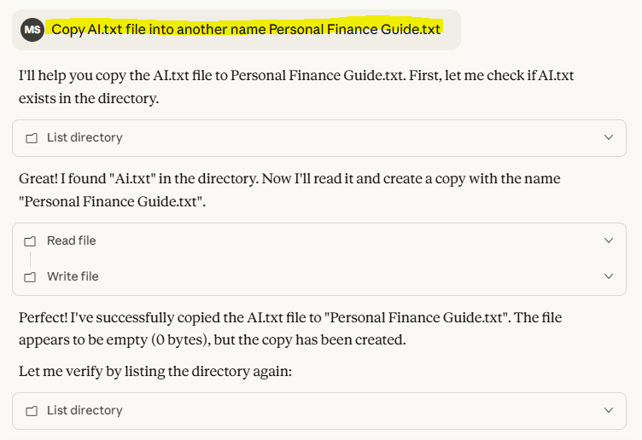
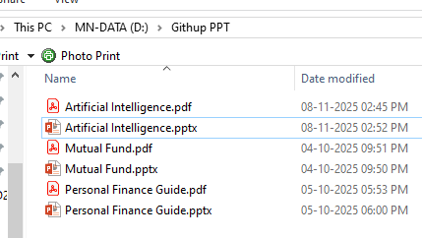
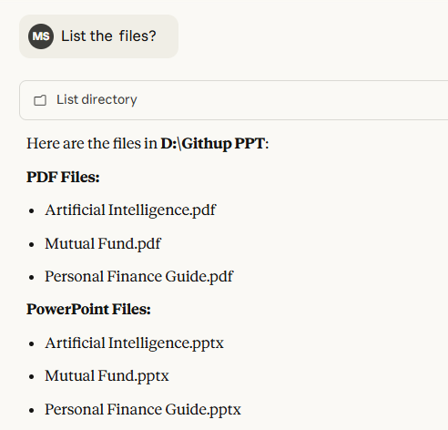
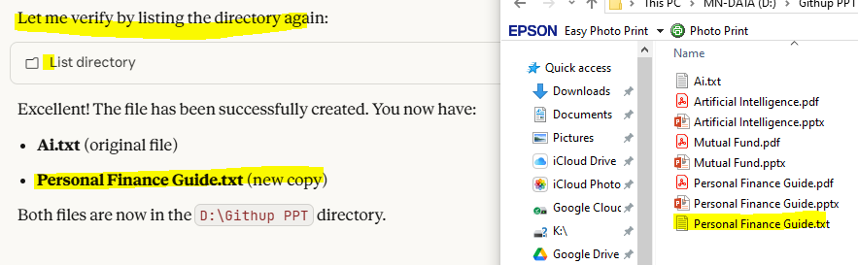
7
5
6
8

Slide 13
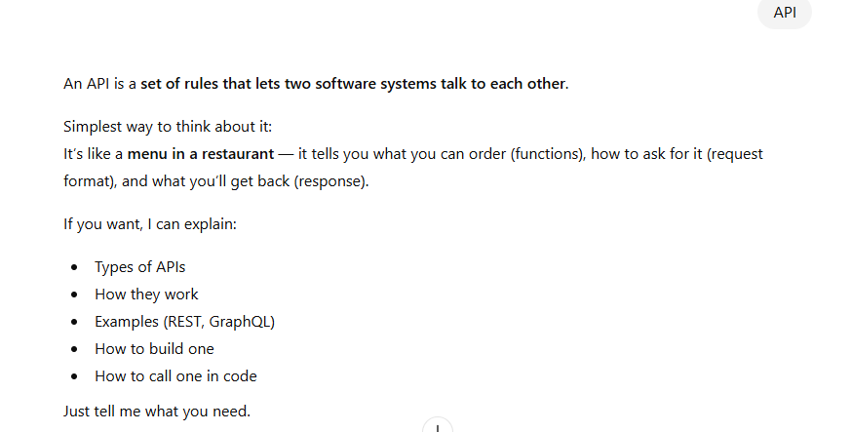
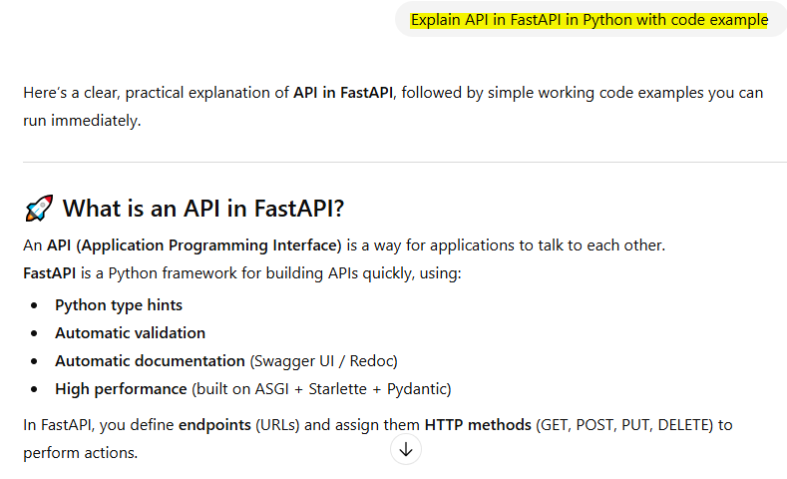
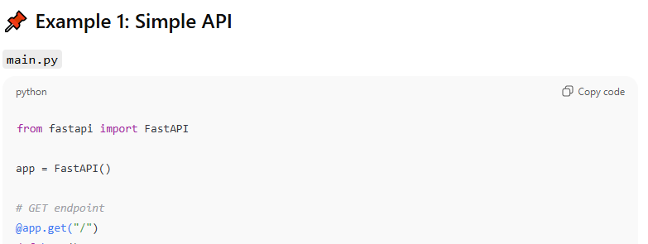
AI Prompt Engineering:
Explain | API | FastAPI in Python | With Code Example
Instructions | Input | Context | Output
Explain API in FastAPI in Python with code example
Simple Prompting
Improved Prompting
Instructions
Input
Context
Output

Slide 14
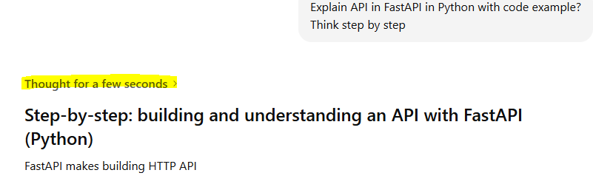
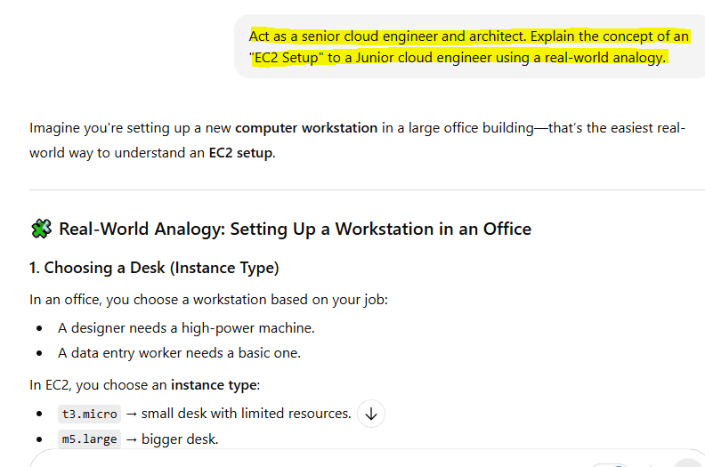
Continued…
Explain API in FastAPI in Python with code example?
Think step by step
Chain of Thought
Act as a senior cloud engineer and architect. Explain the concept of an "EC2 Setup" to a Junior cloud engineer using a real-world analogy.

Slide 15
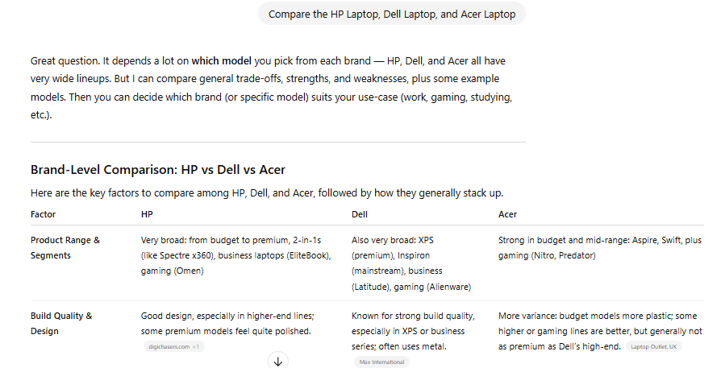
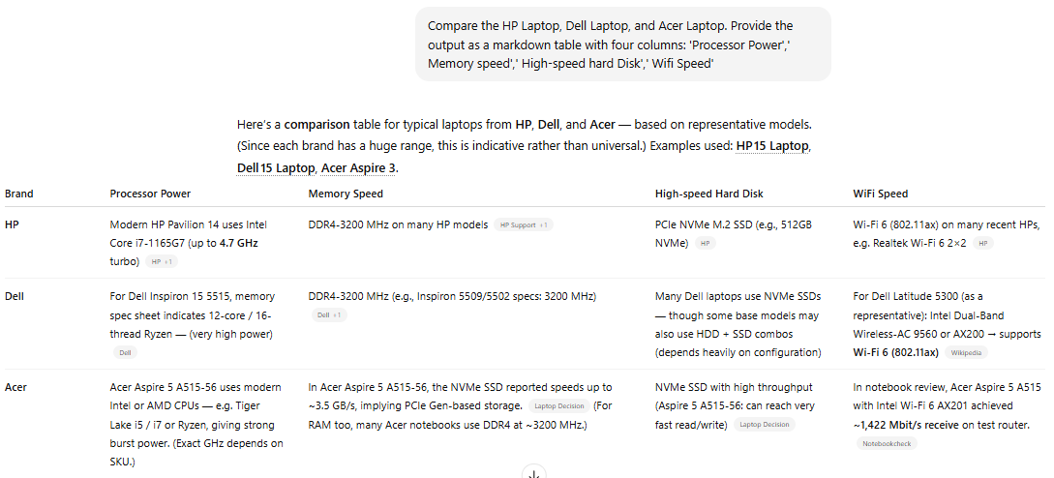
Continued…
Structured Output Prompting
Compare the HP Laptop, Dell Laptop, and Acer Laptop
Compare the HP Laptop, Dell Laptop, and Acer Laptop. Provide the output as a markdown table with four columns: 'Processor Power',' Memory speed',' High-speed hard Disk',' Wi-Fi Speed'

Slide 16
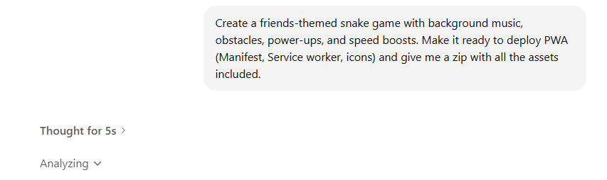

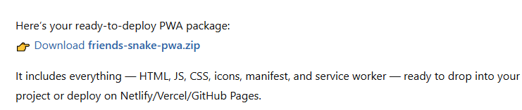
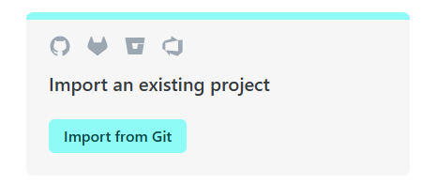
Ai Prompting Code Download Example: Create a friends-themed snake game with background music, obstacles, power-ups, and speed boosts. Make it ready to deploy PWA (Manifest, Service worker, icons) and give me a zip with all the assets included.
1
2
3
4
https://www.netlify.com/
https://app.netlify.com/teams/mohan4295work/projects

Slide 17

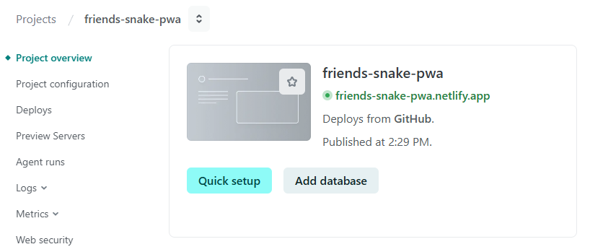
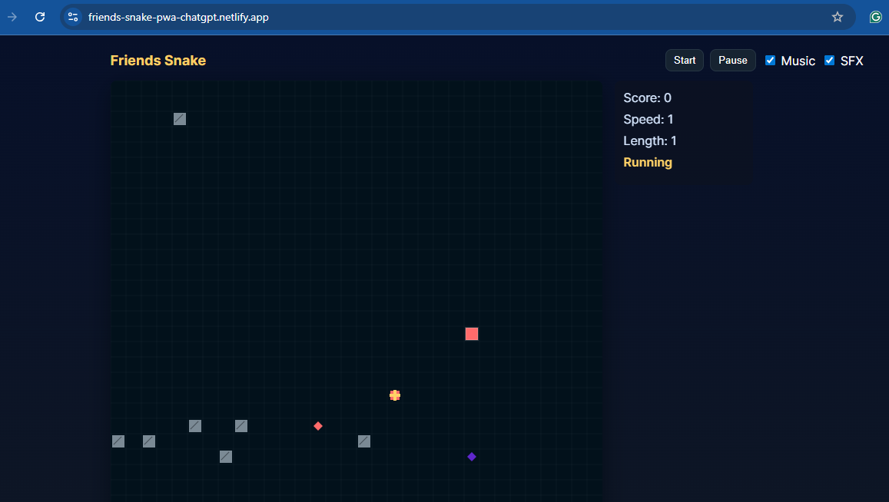
5
6
7
https://friends-snake-pwa-chatgpt.netlify.app/

Slide 18
AI as a tool to get the job done better!
Programmer Productivity
Testers Productivity
UI Programming Productivity
SQL Query Conversion Productivity
…..etc.

Slide 19
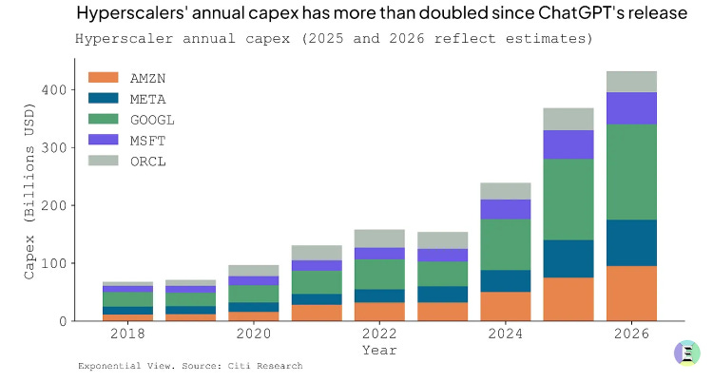
Is the AI Bubble About to Burst?
Derek Thompson on AI bubble https://www.derekthompson.org/p/this-is-how-the-ai-bubble-will-pop
MIT report https://fortune.com/2025/08/18/mit-report-95-percent-generative-ai-pilots-at-companies-failing-cfo/

Slide 20



My Blogger & Links
Documents Download → https://github.com/mohan4295work/Doc/blob/main/Artificial%20Intelligence.pdf
Gen AI & Open Source Tools
https://chatgpt.com/
https://claude.ai/
https://gemini.google.com/
https://chat.deepseek.com/
https://webenoid.com/
https://www.netlify.com/
https://gitlab.com/mohan4295work
https://github.com/mohan4295work
https://mohan4295.blogspot.com/

Slide 21
Reference Links
AI Keynote: Sridhar Vembu https://youtu.be/df4onYIfTwo
Ai Beginners https://youtu.be/D1eL1EnxXXQ
Is the AI Bubble About to Burst? https://youtu.be/OJKPrJ0wNvc
Generative AI vs AI agents vs Agentic AI https://youtu.be/O2gerCxEXvc
Ai Prompt Engineering https://youtu.be/n0VpK1RfYGA

